Slide 1



Banking System Database
Presenting by: Zareena Fathima
Institute: IT Vedanth
Notes:
1

Slide 2
Introduction
A Banking System database stores and manages details about:
Customers
Accounts
Transactions
Employees
It helps in efficient handling of banking operations.
Designed using MySQL with structured relationships.
Notes:
2

Slide 3
Project Objectives
Design a normalized database for a banking system.
Demonstrate SQL operations:
Data Definition (CREATE)
Data Manipulation (INSERT, UPDATE, DELETE)
Queries (SELECT, JOIN, GROUP BY, HAVING)
Generate business insights using SQL queries and functions.
Ensure data integrity using primary and foreign keys.
Notes:
3

Slide 4
Database Design
Database Name: BankingSystem_db
Main Entities (Tables):
Customers
Accounts
Transactions
Employees
Relationships:
One customer → many accounts
One account → many transactions
Branch common among employees and accounts
Notes:
4

Slide 5
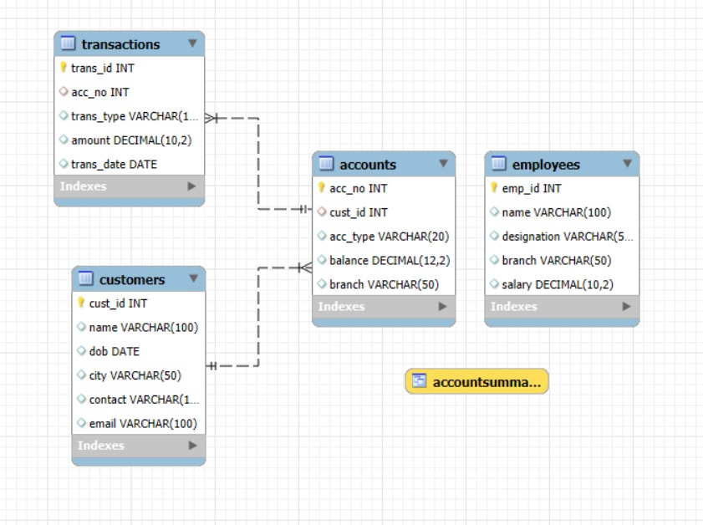
Entity Relationship Diagram
Notes:
5

Slide 6


Database Schema :
Four Core Tables
A robust banking system relies on interconnected tables. Each table serves a specific purpose whilst maintaining data integrity through primary and foreign keys.
Customers
Personal identification, contact details, and demographic information for each customer.
Accounts
Account numbers, types (Savings/Current), balances, and branch associations linked to customers.
Transactions
Deposits and withdrawals tracked with amounts, dates, and account references.
Employees
Staff information including designations, branches, and salary details.
Notes:
6

Slide 7

Creating the Foundation
Table Creation
Fundamentals
Establish data structure with precise column definitions, data types, and constraints. Primary keys ensure unique identification, whilst foreign keys enforce referential integrity across related tables.
Data Types Matter
Key Constraints
INT for numeric IDs and quantities
PRIMARY KEY ensures uniqueness
VARCHAR for variable-length text
FOREIGN KEY maintains relationships
DECIMAL for monetary values
Prevents orphaned records
DATE for temporal data
Enforces data consistency
Notes:
7

Slide 8
Population Data: The Banking Community
Ten customers across major Indian cities form our banking network. Each customer profile includes contact information, date of birth, and location data, establishing the foundation for account creation and transaction processing.
Customer Name
City
Account Type
Balance (₹)
Arjun Sharma
Mumbai
Savings
50,000
Priya Verma
Delhi
Current
75,000
Rohan Das
Bangalore
Savings
62,000
Anjali Singh
Chennai
Savings
48,000
Vikas Rao
Hyderabad
Current
89,000
Notes:
8

Slide 9

Data Manipulation
Updating and Maintaining Records
SQL's UPDATE statement modifies existing data efficiently. From depositing funds to applying salary increments, these operations maintain accurate financial records. Always disable safe updates when necessary for bulk operations.
Account Balance Updates
Salary Increments
UPDATE Accounts SET balance = balance + 10000 WHERE acc_no = 2;
Apply percentage-based salary adjustments across all employees. Multiply salary by 1.10 for 10% increase. Remember to manage SQL_SAFE_UPDATES during bulk changes.
Record Deletion
DELETE FROM Transactions WHERE trans_id = 4;
Notes:
9

Slide 10

Retrieving Related Data: JOIN Operations
JOINS combine data across multiple tables by matching common columns. Different JOIN types serve distinct purposes: INNER JOIN retrieves matching records, LEFT JOIN preserves all rows from the left table, whilst RIGHT JOIN maintains right table completeness.
01
02
INNER JOIN
LEFT JOIN
Returns only records with matches in both tables. Essential for finding customers with active accounts and transaction history.
Preserves all records from the left table, adding matching data from the right. Useful for identifying employees with zero assigned accounts.
03
RIGHT JOIN
Opposite of LEFT JOIN—maintains all right table records. Reveals all accounts even when employee branch associations are incomplete.
Notes:
10

Slide 11

Aggregate Functions: Summarising Data
SQL aggregate functions transform detailed records into meaningful summaries. COUNT, SUM, AVG, MAX, and MIN provide crucial insights into banking operations, from total balances to highest earners.
10
749000
74900
Total Customers
Total Bank Balance
Average Account Balance
COUNT(*) counts all records across the entire customer base.
SUM(balance) aggregates all account balances system-wide.
AVG(balance) provides mean balance across all accounts.
92000
Maximum Salary
MAX(salary) identifies the highest-paid employee in the system.
Notes:
11

Slide 12

Advanced Querying Techniques
Subqueries and Complex Filtering
Subqueries enable nested queries for sophisticated data retrieval. Find customers with above-average balances, identify employees earning more than the mean salary, or locate branches with the highest total deposits through layered query logic.
Subquery Examples
Business Applications
Average balance calculation as a condition
Identify affluent customers
Rank branch performance
Maximum salary identification
Find VIP account holders
IN operator for filtered results
Analyse transaction patterns
Nested WHERE clauses
Notes:
12

Slide 13




Views and Business Analytics
Views create reusable query templates that simplify complex joins. AccountSummary combines customer names, account numbers, types, balances, and branches into a single virtual table. Views enhance security by exposing only necessary columns and improve query consistency across the organisation.
Create View
Define reusable query combining multiple tables with joins and calculations.
Query View
Use views exactly like tables—simpler syntax for complex operations.
Filter Results
Apply WHERE conditions to view results for targeted analysis and reporting.
Notes:
13

Slide 14








Strategic Business Insights
Advanced analytics reveal banking operations patterns. Highest-performing branches by total deposits, customer activity rankings, deposit-to-withdrawal ratios, and employee productivity metrics drive strategic decision-making. Combine GROUP BY with aggregate functions to extract actionable intelligence.
Branch Performance
Customer Activity
Rank branches by total deposits and account holdings for resource allocation.
Identify most active customers by transaction count and volume for relationship management.
Employee Insights
Transaction Analysis
Analyse staffing levels, salary distributions, and branch assignments for operational efficiency.
Measure deposit versus withdrawal patterns to assess cash flow health by branch.
Notes:
14

Slide 15
Analytical Insights
Highest transaction per account
Total deposits and withdrawals
Most active customer (by transaction count)
Employees earning above average
Branch with highest deposits
Notes:
15

Slide 16
Key Results
Total Customers: 10
Top Branch by Balance: Mumbai Main
Highest Paid Employee: Manoj Kumar (₹92,000)
Most Active Customer: [From query result]
Total Bank Balance: [Query output from SUM(balance)]
Notes:
16

Slide 17
Outcomes
Understanding of Database Design
Practical use of SQL operations
Use of Joins, Subqueries, Views, Functions
Ability to derive Business Insights from data
Gained skills in MySQL implementation & analysis
Notes:
17

Slide 18
Conclusion
Efficient management of banking operations using SQL
Demonstrated complete CRUD and analytical capabilities
Scalable for real-world applications
Notes:
18

Slide 19
Thank You
Questions?
Notes:
19

